Slide 1

Technological change in agriculture:
A microeconomics perspective
Chris Barrett
Guest Lecture to
IARD 4140/PLSCI 4140/5140: Global Cropping Systems
September 16, 2021

Slide 2
A few key questions
Let’s discuss a few key questions.
Why does technological change in agriculture matter to economic development?
How do new technologies arise and diffuse?
Who gains from technological advances? Why?
4) Some implications: IP, R&D financing, complementary (esp. natural) inputs, extension and learning

Slide 3
Why does ag tech change matter?
Ag technological change especially important
“Most of the people in the world are poor, so if we knew the economics of being poor we would know much of the economics that really matters. Most of the world’s poor people earn their living from agriculture, so if we knew the economics of agriculture we would know much of the economics of being poor.”
- Theodore W. Schultz
Opening sentences of 1979 Nobel Prize in Economics lecture

Slide 4
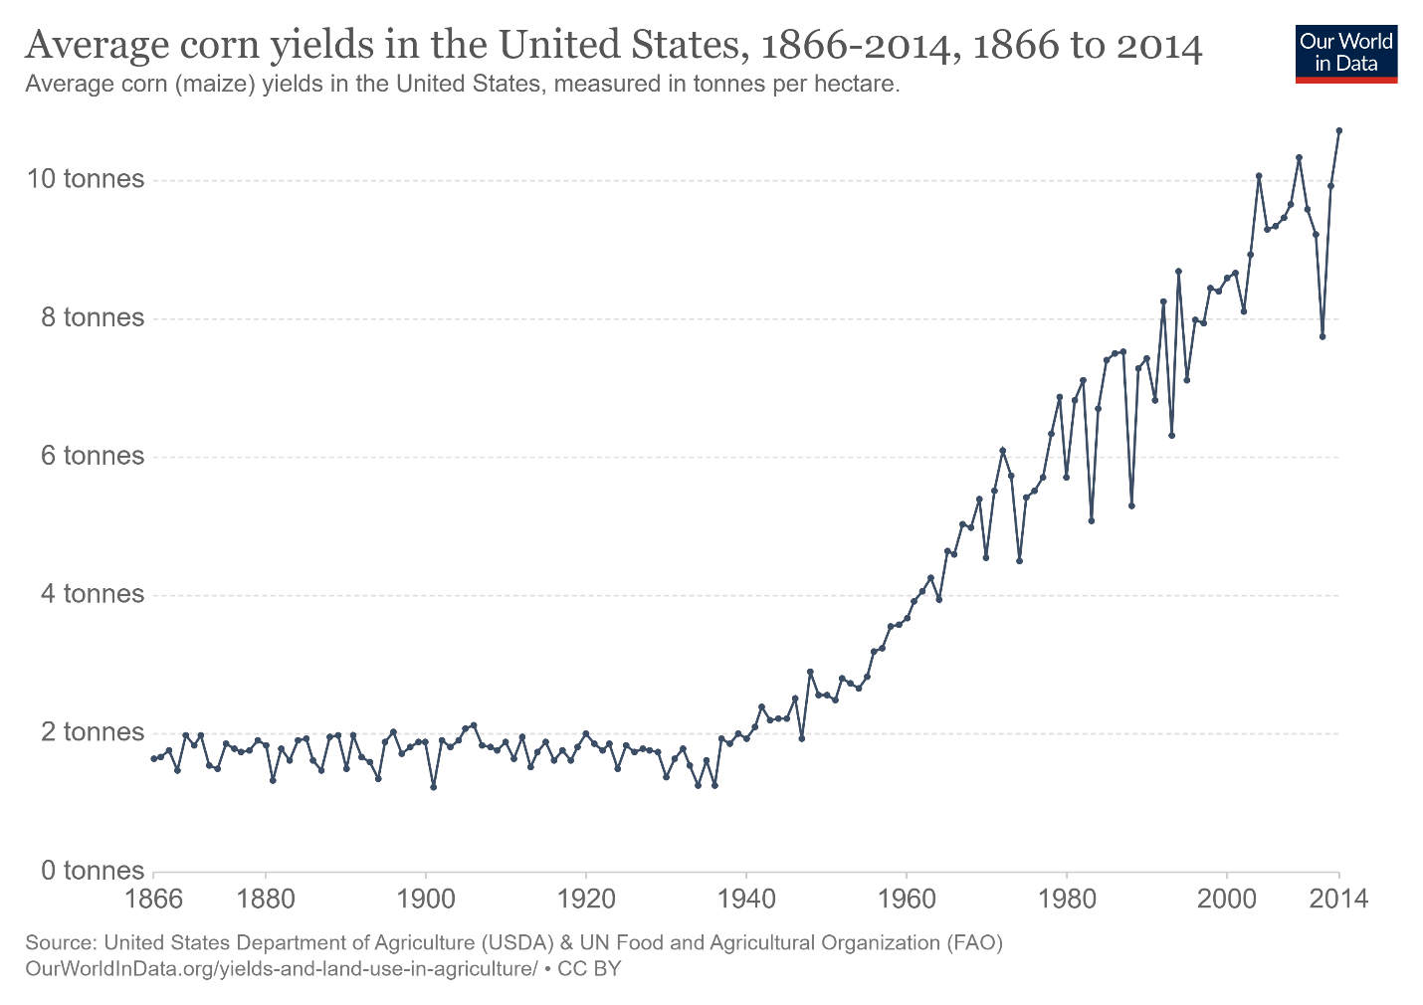
85-90 yrs ago, we faced Global Depression, Dust Bowl in US.
Ag R&E, “New Deal” programs (and WWII) sparked innovation to boost crop yields and reduce hunger … and launched a period of unprecedented agri-prosperity in today’s HICs.
Why does ag tech change matter?

Slide 5
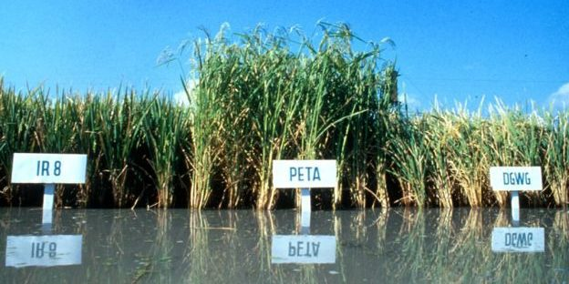
50 yrs ago, facing ‘population bomb’ and famines in Asia/Africa, goal was again reduce hunger/raise yields. Science-led effort to ‘grow the pile of rice on the plates of food-short consumers’ led to Green Revolution successes (Norman Borlaug 1970 NPP!)
Why does ag tech change matter?
Photo credit: IRRI

Slide 6
Why does ag tech change matter?
How to meet growing demand for food, fiber and fuel (income, population growth, stature, urbanization)
Finite planetary resources and increasing value to alternate land/water/labor uses
Implication: Must increase output/input to satisfy growing human demand and respect natural scarcity
Inputs = ‘factors of production’, so tech change is growth in ‘total factor productivity’ (TFP)
Also: Various estimates consistently suggest that real economic growth from agriculture is ~3x more effective than non-ag growth in reducing headcount extreme poverty.

Slide 7
Why does ag tech change matter?
What spurs agricultural growth?
Three possible sources of agricultural growth:
Increased use of inputs (land, water, labor, capital) brings more output, but typically at diminishing rate. Implies reduced marginal returns to labor (i.e., lower real wages and higher poverty) and environmental degradation (X⁰ to X¹).
Increased efficiency in using existing inputs and technologies, commonly through extension (Y⁰ to Y¹). But Schultz’s (1964) “poor but efficient” hypothesis suggests limits to this option.
Technological change to increase output potential given same inputs. Requires innovation, diffusion and farmer adaptation to change. This is the main long-term source of productivity growth for sustainable poverty reduction.
Output
New Production Possibility
Production Possibility
Y¹
Y⁰
Input
X⁰
X¹

Slide 8


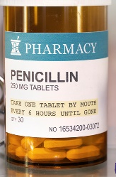
How tech change?
Sources of technological change (innovation)
Induced innovation model: private agents innovate so as to conserve relatively scarce/dear factors and to increase relatively valuable outputs. So ‘factor bias’ in tech change varies by region/crop/era (Hayami & Ruttan).
Strategically targeted investments by not-for-profit donors and governments: CGIAR, GAVI, etc.
Serendipity
Empirical evidence: induced innovation most important. B/c II turns on price signals, easily distorted by policies. And pro-poor innovations undervalued, hence the need for #s 2/3.
Discoveries are typically combinatorial.

Slide 9
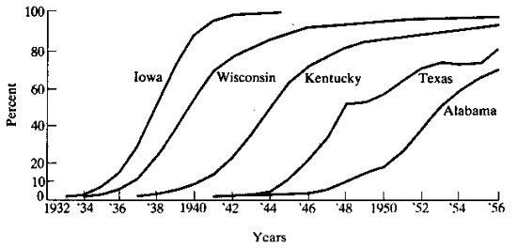
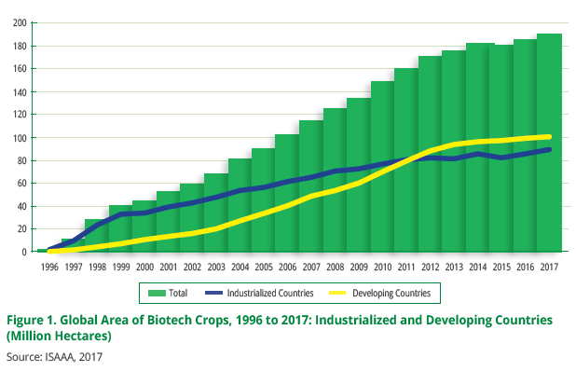
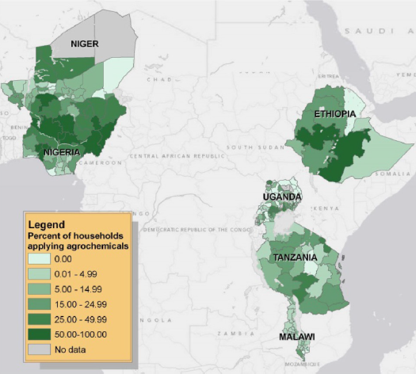
How tech change?
Diffusion of innovations
Standard diffusion pattern is logistic …
(Griliches, Econometrica, 1957 on hybrid corn diffusion in the US)
Rapid diffusion of GM crops worldwide … fastest ag innovation diffusion in history!
Sheahan and Barrett, Food Policy 2017

Slide 10
How tech change?
Tech diffusion
In Vietnam, farm machinery diffused rapidly 1992-2016. Clear economies of scale cause a pronounced positive - machinery ownership relationship. But rental markets virtually erased the farm size gradient in machinery use, leading to rapid mechanization as real wages rose inducing substitution of machines for workers.
Liu et al. Food Policy 2020

Slide 11
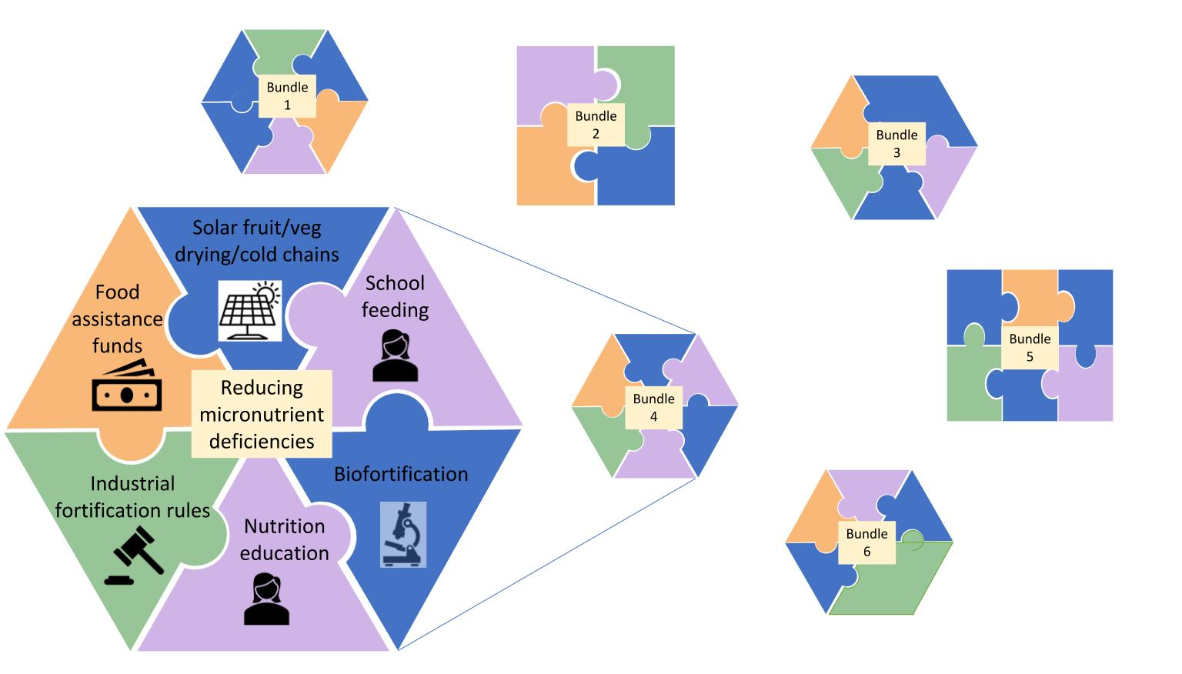
How tech change?
Importance of socio-technical innovation bundling:
  No magic bullets exist. Multiple constraints; relaxing just one limits progress. Must realize synergies to adapt/scale.
  Must address political economy of spillovers and creative destruction. Coalitions from bundling can overcome incumbent status quo bias.
  Heterogeneous needs require
  bundled solutions
Barrett et al. 2021: https://blogs.cornell.edu/nature-sustainability/

Slide 12
Who gains and why?
“Technology treadmill” and gains from change
Naïve model
If demand is perfectly elastic, gains accrue to producers.
But when, if ever, does this really happen?
Small-scale change: early adopters (who?)
Perfect market integration … export surplus production
New Supply
Price
Original Supply
Demand
P
Producer
Surplus
Added Producer
Surplus
Quantity

Slide 13
Who gains and why?
“Technology treadmill” and gains from change
Irony: big winners from most ag tech change are typically consumers not producers. Why?
Price
More realistic model
Price inelastic demand.
Fallacy of composition: what’s true at small scale (tech. change profitable for first few adopters) not true at large scale.
Hence tech treadmill
Demand
New Supply
Original Supply
Consumer
Surplus
P ^{old}
Old Producer
Surplus
New Consumer
Surplus
P ^{new}
New Producer
Surplus
Quantity

Slide 14
Who gains and why?
So how does ag tech change matter?
Increase farm profits, at least for early adopters: Those with best access to ICT, extension, credit/insurance, input and output markets, etc. These farmers gain from yield increases, cost reductions, or both.
Boost rural labor demand: Rural poor typically work off-farm (at least part-time). Enjoy labor market gains, both through more hours worked and higher real wages.
Reduce food prices: If enough adoption, aggregate supply shifts and prices fall (by how much depends on integration with national and global markets). Poor usually net food consumers who gain.
Result: Broad-based but uneven and evolving gains

Slide 15
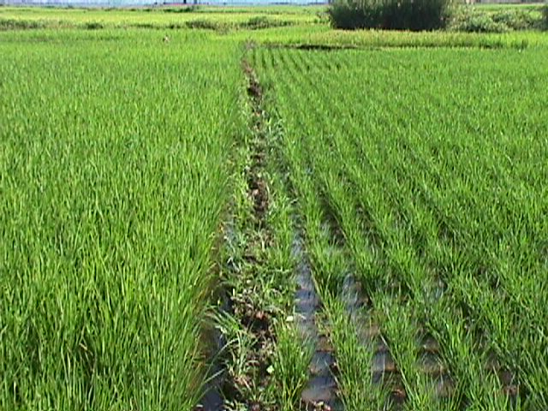
Who gains and why?
Adding it all up … an example from Madagascar:
A doubling of rice yields:
reduces the share of food insecure
households by 38%
shortens the average hungry period
by 1.7 months (1/3)
increases real unskilled wages in
lean season by 89 % (due to both
price and labor demand effects)
All the poor benefit: unskilled
workers, consumers, and net seller producers
… the poorest gain most.
(Source: Minten and Barrett, World Development, 2008).

Slide 16
Implications
“Technology treadmill” and gains from change
Some key policy implications
Intellectual Property
What differences emerge from open source/public licensing vs. private IP?
How does the income/wealth of target consumers influence induced innovation?
Financing
Who should pay for R&D? How does it depend on IP?

Slide 17
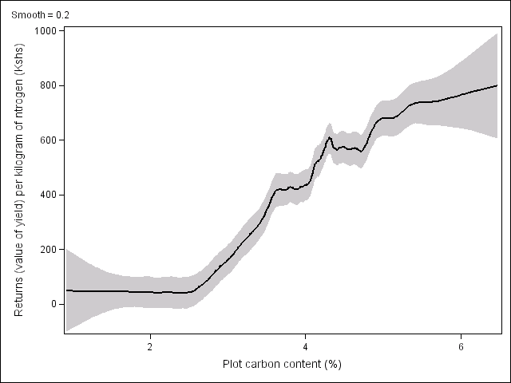
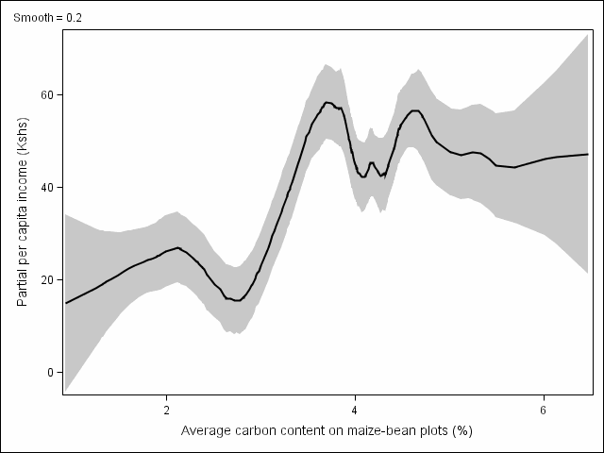
Implications
Complementary (esp. natural) inputs:
Inorganic fertilizer in w. Kenya (Marenya & Barrett 2009).
Above red line: fertilizer profitable
Value of maize from 1 kg of nitrogen
Kenya rural poverty line
Cost of 1kg nitrogen
Below red line: fertilizer unprofitable
(Source: Marenya and Barrett, AJAE 2009).

Slide 18
Implications
Learning and extension:
Need to promote/subsidize learning (by doing and from others) about new technologies. Social pressures seem to matter too …
Example: SRI adoption in Bangladesh
(Source: Barrett et al. AJAE 2021)

Slide 19

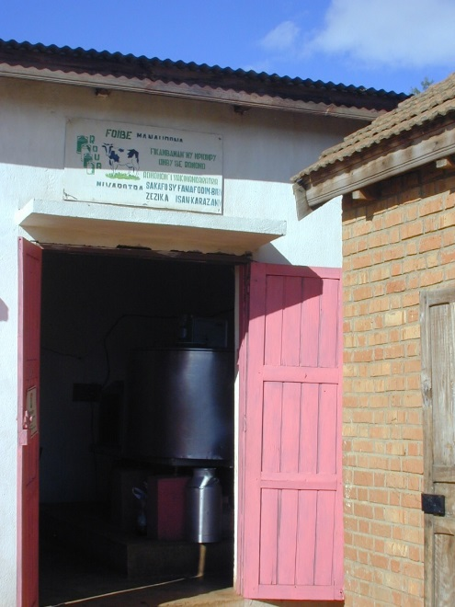
Questions?

